Slide 1
Potato Field Analyzing
An algorithmic approach to measuring the distances between potato plants with drone imagery

Slide 2
Problem Definition
The correct distances between potatoes in a field is essential for proper plant growth.
However, current measurement practices are inaccurate, time consuming, and not representative of the entire field
Gathering a large amount of accurate measurements will help identify problems in planting accuracy.
It is hypothesized that improving planting accuracy will result in higher potato yields from each field.

Slide 3
Solution Description
Pictures of each field were taken by a drone equipped with a high definition camera.
Each picture contains approximately 1000 plants.
Each picture was then analyzed, and the distances between plants was measured using a proprietary algorithm.
This algorithm outputs analyzed pictures of the field, as well as excel documents containing additional information which can be used for further analysis

Slide 4
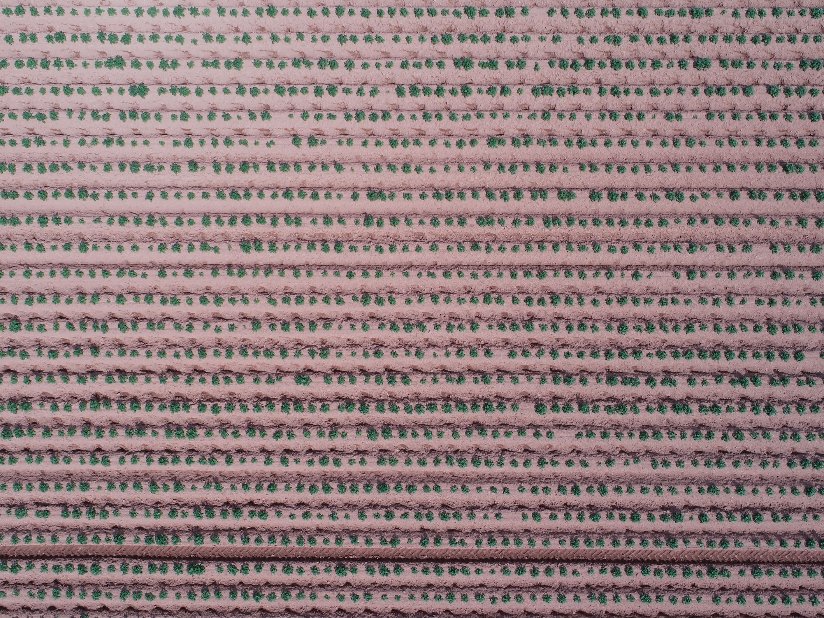
Field before analysis

Slide 5
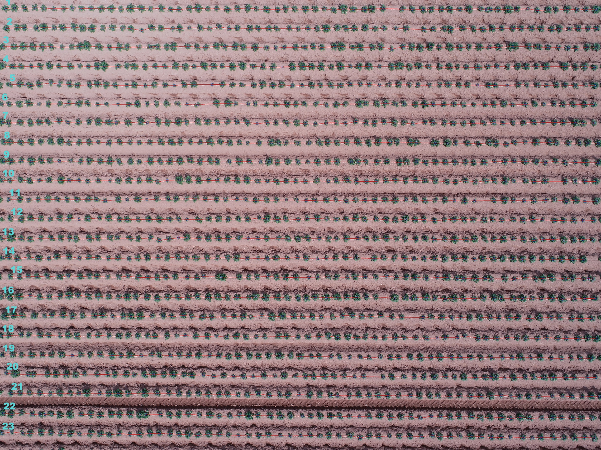
Field after analysis

Slide 6
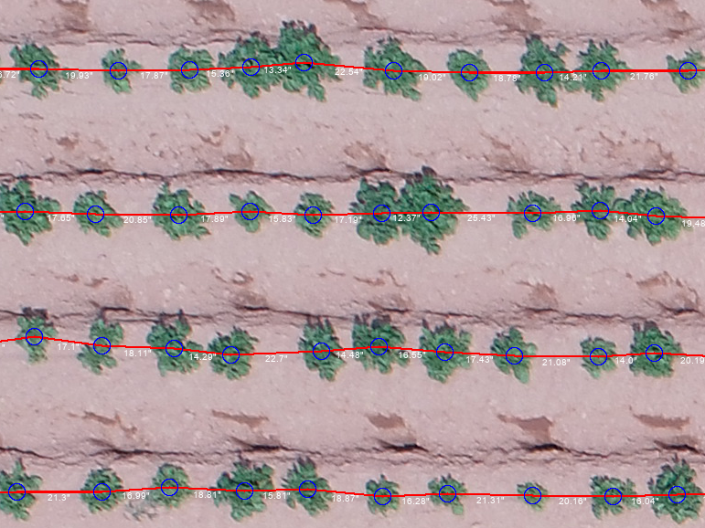
Analysis (Zoomed in)

Slide 7
Data Output
Row Information
Row ID | Ideal Number of Plants | Actual Number of Plants | Average Gap (Inches) | Median Gap (Inches) | Standard Deviation (Inches) | Latitude | Longitude | Image Name
1 | 69 | 62 | 17.99363 | 18.09755 | 3.370222 | 46.47725 | 63.63119 | DJI_0009_ChappelSiloWhole.JPG
2 | 69 | 61 | 18.30366 | 17.97149 | 3.316894 | 46.47725 | 63.63119 | DJI_0009_ChappelSiloWhole.JPG
3 | 69 | 61 | 18.37137 | 17.87438 | 3.421595 | 46.47725 | 63.63119 | DJI_0009_ChappelSiloWhole.JPG
4 | 69 | 61 | 18.30486 | 18.11421 | 2.932955 | 46.47725 | 63.63119 | DJI_0009_ChappelSiloWhole.JPG
5 | 68 | 61 | 18.12904 | 18.26988 | 3.280627 | 46.47725 | 63.63119 | DJI_0009_ChappelSiloWhole.JPG
6 | 69 | 60 | 18.62742 | 18.3266 | 3.38308 | 46.47725 | 63.63119 | DJI_0009_ChappelSiloWhole.JPG
7 | 69 | 61 | 18.31997 | 18.68286 | 2.442246 | 46.47725 | 63.63119 | DJI_0009_ChappelSiloWhole.JPG
8 | 69 | 60 | 18.70603 | 19.03443 | 3.755257 | 46.47725 | 63.63119 | DJI_0009_ChappelSiloWhole.JPG
9 | 69 | 61 | 18.41405 | 18.55777 | 2.533758 | 46.47725 | 63.63119 | DJI_0009_ChappelSiloWhole.JPG
10 | 69 | 60 | 18.70521 | 18.33805 | 3.109029 | 46.47725 | 63.63119 | DJI_0009_ChappelSiloWhole.JPG
Distance Information
Gap ID | Distance (Inches) | Row ID | Latitude | Longitude | Image Name
1 | 16.76 | 1 | 46.47725 | 63.63119 | DJI_0009_ChappelSiloWhole.JPG
2 | 19.26 | 1 | 46.47725 | 63.63119 | DJI_0009_ChappelSiloWhole.JPG
3 | 19.05 | 1 | 46.47725 | 63.63119 | DJI_0009_ChappelSiloWhole.JPG
4 | 16.51 | 1 | 46.47725 | 63.63119 | DJI_0009_ChappelSiloWhole.JPG
5 | 18.59 | 1 | 46.47725 | 63.63119 | DJI_0009_ChappelSiloWhole.JPG
6 | 18.1 | 1 | 46.47725 | 63.63119 | DJI_0009_ChappelSiloWhole.JPG
7 | 16.09 | 1 | 46.47725 | 63.63119 | DJI_0009_ChappelSiloWhole.JPG
8 | 16.96 | 1 | 46.47725 | 63.63119 | DJI_0009_ChappelSiloWhole.JPG
9 | 18.55 | 1 | 46.47725 | 63.63119 | DJI_0009_ChappelSiloWhole.JPG
10 | 18.57 | 1 | 46.47725 | 63.63119 | DJI_0009_ChappelSiloWhole.JPG

Slide 8
Early Results
Min Accuracy | 98.237%
Max Accuracy | 100.000%
Average Accuracy | 99.15%
Margin of Error | 0.78326%
Lower Confidence | 98.36%
Upper Confidence | 99.93%
Some fields are overcrowded, but most are underplanted. Early aggregated results (pending full analysis) indicate the average field to have an opportunity to improve yield by 4.06% - 4.13% by improving planting accuracy.

